Slide 1
Junctional & Techinical

Slide 2
Junctional Strips
Accelerated Junctional
Junctional Escape
Junctional Tachycardia
Premature Junctional Complex

Slide 3
Accelerated
Rhythm, QRS, and Rate will be normal (60-100)
P Waves are either, hidden or after and if present will be inverted
PR I – Undeterminable

Slide 4
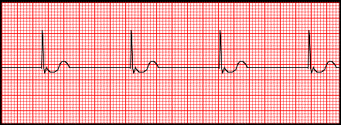
Junctional Escape
Can happen in sinus arrest or PAC
Rhythm will be Regular, QRS Normal
Rate will be Brady 40-60
P Waves hidden, after, or inverted.
PRI Undeterminable.

Slide 5
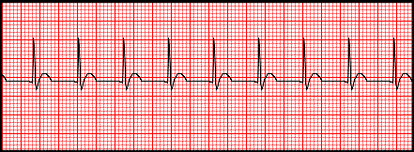
Junctional Tachycardia
Comes from Bundle of HIS
3+ PJC
Rate of > 100
Rhythm will be normal, QRS Normal
P Waves hidden, after, or inverted.
PRI Absent or short <.12

Slide 6
Premature Junctional Complex
AV Site Fires spontaneous (Before SA)
Interrupts sinus
QRS Narrow (<.10sec)
P wave hidden, after, or inverted.
PRI Absent or short

Slide 7
Technical

Slide 8
Gain vs Speed
Gain
Speed
Standard = 1mm = 1mV
5mm = .5mV
10mm = 1.0mV
Standard Rate is 25mv/s
1mm = 0.04 sec
5mm = .20 sec
AKA Sweep Speed

Slide 9
What if?
Complex's
Rate
Reduce gain
Only if complex if off chart
Increase gain
Only if complex is too little to read.
Increase speed. (Too fast)
50mm/sec
Decrease speed (too slow)
10mm/sec

Slide 10
Interference
EKG machines are electronic, subject to interference.
60 cycle interference
Muscle Tremors
Somatic Tremor
Seizure Activity
Wi-Fi Single
Cell Phone
Poor Connectivity

